Slide 1
Structures in C
Lecture 17a

Slide 2
Structure
Compound data type (grouping more types together)
  Each structure can be seen as a record
  Elements of the structure are fields of the record
Derived data types
  Types that are defined using known types
  Structure is a derived type
Compare structures to arrays
  In array, all elements are of the same type
  In structure, each element can have its own type

Slide 3
Define the Structure
Create a structure that contains
  Name (char [31])
  Year of birth (int)
  Height in inches (int)
How to encode it in C?
    struct person_s
    {
    char name[31];
    int year_birth;
    int height;
    }
  Include this on header file (or on top)
  You can then declare new variables of that type

Slide 4
Declaring Variables of Structure Type
Single structure
  struct person_s person;
  struct person_s another_person;
Array of structures
  struct person_s people[100];
  struct person_s more_people[1000];
Don’t forget “struct”!

Slide 5
Another Way of Defining the Structure
Include this in your header file (or on top)
    typedef struct
    {
    char name[31];
    int year_birth;
    int height;
    } person_t;
Now we can omit struct when declaring variables
  person_t person;
  person_t another_person;
  person_t people[100];
  person_t more_people[1000];

Slide 6
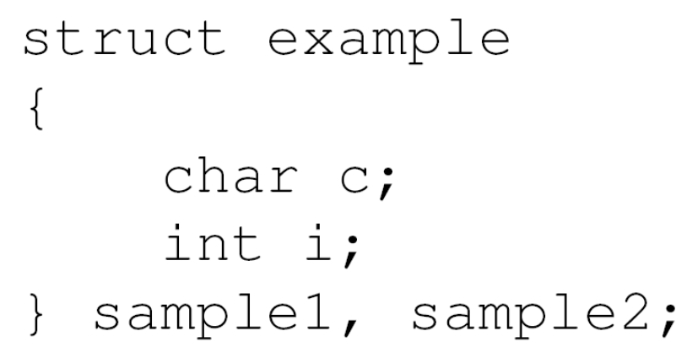
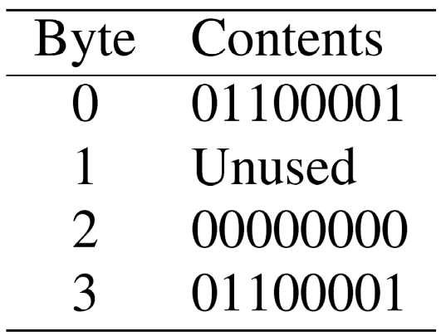
Structures Cannot Be Compared Directly
Structures may not occupy consecutive bytes
  Some machines store all data only at certain memory boundaries
    E.g. each variable starts at even address
  Structures may have holes in them
    Bytes that are not used by any field
Example (with 2-byte integer with 2-byte words)

Slide 7
Structures Cannot Be Compared Directly
Lesson
  Never compare structures like this
    person_t person1;
    person_t person2;
    …
    if (person1 == person2)
    …
How to compare structures?
  Compare manually field by field
  In whatever way you want them to be compared

Slide 8
Initializing Structures
If memory allocation is permanent (static/external), then we can initialize the structure
Unspecified array elements filled with 0s
Example
static person_t
leader = {“John Red”, 1961, 73},
president,
people[100] = {
{ “Jim Green”, 1968, 80 },
{ “Joe Blue”, 1975, 75 }
}; Rest of structure filled with 0s

Slide 9
Assigning Structures
One structure can be assigned to another
  All elements are copied to the target structure
  Example
    president = leader;
    person[3] = person[1];
  We must be careful when dynamic structures are used though (via pointers), e.g.
  typedef struct matrix_t
  {
  int m;
  int n;
  int **a;
  };

Slide 10
Accessing Members of Structures
Use dot operator .
  structure.member refers to “member” of “structure”
  You can work with these like with other variables (of that type)
Example
  president.name
  people[0].year_birth
  people[i].height
  people[i].name[j]

Slide 11
Passing Structures to Functions
Three basic approaches
  Pass individual structure members
  Pass an entire structure
  Pass a pointer to a structure
Differences
  First two approaches pass actual values
  Last one passes only a pointer to memory location

Slide 12
Example
Print out the content of the structure
  void print_person( person_t p )
  {
  printf("-------------------------------\n");
  printf("Name: %s\n",p.name);
  printf("Year of Birth: %d\n",p.year_birth);
  printf("Height: %d\'%d\"\n",
  p.height/12, p.height%12);
  }

Slide 13
Example: All Together Now 1/3
#include <stdio.h>
typedef struct
{
char name[31];
int year_birth;
int height;
} person_t;
void print_person( person_t p )
{
printf("-------------------------------\n");
printf("Name: %s\n", p.name );
printf("Year of Birth: %d\n", p.year_birth );
printf("Height: %d\'%d\"\n",p.height/12,p.height%12); }

Slide 14
Example: All Together Now 2/3
int main()
{
static person_t
leader = { "John Red", 1961, 73 },
president,
people[100] =
{
{ "Jim Green", 1968, 65 },
{ "Joe Blue", 1975, 70 }
};
print_person( leader );
print_person( people[0] );
print_person( people[1] );
}

Slide 15
Example: All Together Now 3/3
$ gcc struct1.c
$ ./a.out
  -------------------------------
  Name: John Red
  Year of Birth: 1961
  Height: 6'1"
  -------------------------------
  Name: Jim Green
  Year of Birth: 1968
  Height: 5'5"
  -------------------------------
  Name: Joe Blue
  Year of Birth: 1975
  Height: 5'10"

Slide 16
Pointers to Structures
Pointer to structure
  Points to memory location.
  At that location, we expect a structure.
Declaring pointers to structures
  Same as with any other data types.
  Example
    person_t *ptr;
Assigning pointers to structures
  Must assign to the same data type.
  Can be made to point to any existing structure.
  Examples
    ptr = &leader;
    ptr = &person[0];

Slide 17
Accessing Structure Members via Pointers
Standard approach: Operator “->”
  Similar to the dot operator for structures.
  But here instead of dot we use “->”
  Examples
    ptr->name
    ptr->year_birth
Another approach: Use indirection operator
  If ptr is a pointer to a structure, then *ptr is that structure (indirection op. *…)
  And then we can use dot operator like before…
  Examples
    (*ptr).name
    (*ptr).year_birth
  Note: Must use brackets cause “.” has higher priority than *

Slide 18
Accessing Structure Members via Pointers
These denote the same
  person[0].name
  (&person[0])->name
These also denote the same
  ptr->name;
  (*ptr).name;

Slide 19
Example
Print out the content of the structure (pass the structure)
  void print_person( person_t p )
  {
  printf("-------------------------------\n");
  printf("Name: %s\n", p.name );
  printf("Year of Birth: %d\n", p.year_birth );
  printf("Height: %d\'%d\"\n",
  p.height/12, p.height%12 );
  }
  ...
  person_t leader = ...;
  person_t *ptr = &leader;
  print_person(leader);
  print_person(*ptr);

Slide 20
Example Revisited: Another Way
Print out the content of the structure (pass a pointer/reference to the function)
  void print_person2( person_t *p )
  {
  printf("-------------------------------\n");
  printf("Name: %s\n", p->name );
  printf("Year of Birth: %d\n", p->year_birth );
  printf("Height: %d\'%d\"\n",
  p->height/12, p->height%12 );
  }
  ...
  person_t leader = ...;
  person_t *ptr = &leader;
  print_person2(&leader);
  print_person2(ptr);

Slide 21
Example Revisited: Yet Another Way
Print out the content of the structure (pass records one by one)
void print_person3( char name[31],
int year,
int height )
{
printf( "-------------------------------\n“ );
printf( "Name: %s\n", name);
printf( "Year of Birth: %d\n", year);
printf( "Height: %d\'%d\"\n",height/12,height%12 );
}
...
person_t leader = ...;
person_t *ptr = &leader;
print_person3(leader.name, leader.year_birth, leader.height);
print_person3(ptr->name, ptr->year_birth, ptr->height);

Slide 22
Passing Structures to Functions: Best Way
Best approach
  Pass structure by reference (pointer)
  This doesn’t require entire structure to be copied
  Neither the list of all records to pass

Slide 23
Returning Structures from Functions
Two ways
  Return a pointer to structure
  Change structure pointed to by function argument
Important
  Cannot return the structure type itself!

Slide 24
Example: Find Height
person_t *find_height( person_t *p,
int np,
int height )
{
int i;
for ( i = 0; i < np; i++ )
if ( p[i].height == ht )
return ( p + i );
return (person_t*) NULL;
}
...
print_person( *find_height( p, 2, 75 ) );
printf(“name = %s”, find_height( p, 2, 73 )->name );
ptr = find_height( p, 2, 70 );
if ( ptr->year_birth > 1995 )
...

Slide 25
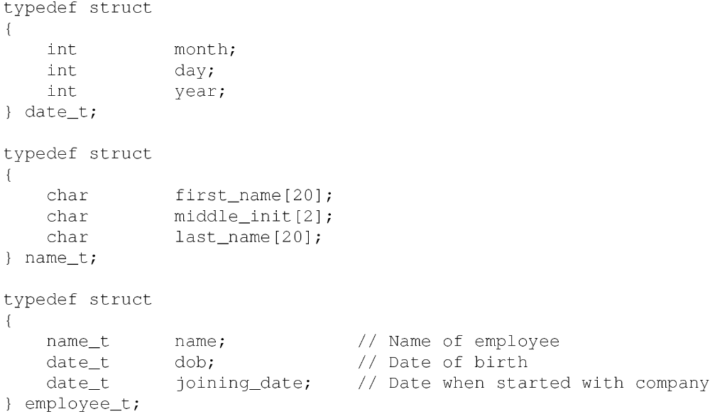
Nested Structures
Structures with structures inside them…

Slide 26
Accessing Nested Structures
Accessing nested structures
  Use “.” operator to access structure inside structure
  Use “.” operator again to access the fields inside
Example
    employee_t emp;
    emp.dob.year = 1940;
    emp.dob.day = 9;
    emp.dob.month = 10;
    strcpy( emp.name.first_name, ”John”);
    ...

Slide 27
Exercise
Create your own structures and arrays of structures
Initialize the structures and change them
Access structure data via pointers
Pass structures in different ways to functions
Create functions that take structures as arguments and possibly modify some structures (like find_height)

